Slide 1
Palindrome Partitioning
(Medium Level Problem)
Your Name: Aqsa Ilyas (BIT-24S-009) Course: Artificial Intelligence

Slide 2
Problem Statement:
Given a string s, partition s such that every substring in the partition is a palindrome.
Return all possible palindrome partitioning's of s.

Slide 3
What is a Palindrome?
A palindrome reads the same forwards and backwards.
Examples:
word “aab”
"a" → palindrome
"aa" → palindrome
"b" → palindrome
"ab" → not palindrome

Slide 4
Example:
Input: “aab”
Output: [["a","a","b"], ["aa","b"]]

Slide 5
Concept of Palindrome partitioning:
Partition the string so that each substring is a palindrome.
Use backtracking to explore all possible partitions.
At each step, check if the substring is a palindrome.
If valid, recurse on the remaining string.
Store partitions that reach the end of the string.
Backtrack to explore all valid combinations.

Slide 6
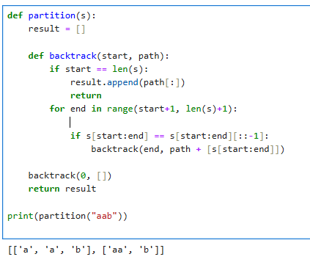
Solution:

Slide 7
Challenges Faced While Solving the Problem
While solving LeetCode Problem 131: Palindrome Partitioning, I encountered the following difficulties:
1. Understanding Backtracking Concept:
In the beginning, it was hard to grasp how backtracking is used to generate all valid palindrome partitions.
I found it confusing to manage recursive calls, current paths, and how to backtrack after each step.
2. Checking Substrings for Palindromes:
I faced issues in correctly identifying palindromic substrings within the given string.
It required checking all possible substrings, which increased complexity.
3. Storing and Returning All Valid Combinations:
Another challenge was how to store each valid partition path and return all such combinations in the required format.

Slide 8
How I Solved the Problem
✅ Studied Examples and Visual Tracing:
I broke down the example "aab" manually to understand how the recursive backtracking works step by step.
✅ Implemented a Palindrome Check Function:
I wrote a helper function that checks if a substring is a palindrome, which helped in reducing errors.
✅ Used Recursion with Backtracking:
I implemented a recursive function where:
- At each step, I checked for palindromes.
- If valid, I added the substring to the current path and recursively called the function on the remaining string.
- Once the end of the string was reached, I added the current path to the result.
- Then I backtracked to explore other possibilities.
✅ Tested With Different Inputs:
I tested my code with various strings (like "aab", "a", "abc", "aaa") to ensure all edge cases are handled.

